Slide 1
INTERNSHIP – ADP CHENNAI
NALLAM, REVANTH

Slide 2
SESSION 1 – OOP and SOLID DESIGN PRINCIPLES
by Navinkumar Krishnan
We discussed the OOP concepts
We understood why design principles are important to build enterprise code
And each of the design principle made meaning for me after the session

Slide 3
SESSION 2 – C# and .NET
by Hari Ramachandran
Many topics like CLR, garbage collection, DLL, Intermediate language, Generic Collections were discussed
Many examples were given for how the design principles are followed in the enterprise code

Slide 4
SESSION 3 – DESIGN PATTERNS
by Hari Ramachandran
This session introduced me to design patterns such as singleton, factory, etc.,
We learnt how inversion of control container is used to make loosely coupled components

Slide 5
EXERCISE 1
To make a family of vehicles with their behaviours (move, park sound horn, etc.,)
The exercise was helpful to get familiar with Visual Studio IDE
I tried to implement the things that I learnt from the above sessions

Slide 6
EXERCISE 2
To make a console application that generates a Newspaper like formatted justified output for the given input text file
The exercise was really interesting and fun
I was able to make my own justification algorithm which also splits the long words based on the chosen readability level
I tried to implement the design patterns to make sure it obeys the design principles and make it as much reusable as possible

Slide 7
SESSION 4 – ASP.NET, Angular JS
by Sathyanarayana Chtirambalam
MVC architecture was discussed
Scripting languages such as HTML, CSS, Angular JS was given a overview to start with the exercise 3

Slide 8
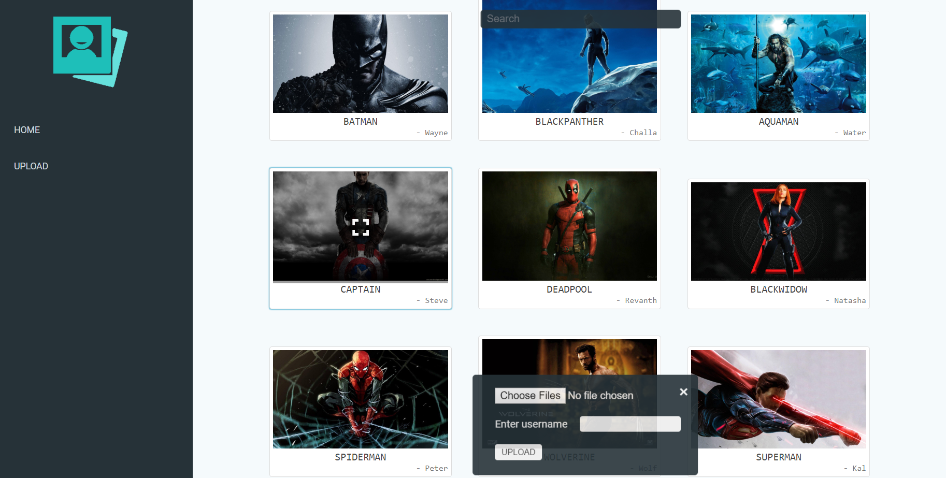
EXERCISE 3
To create a gallery web application using ASP.NET MVC, ASP.NET Web API, and Angular JS
An API is made which communicates with the database where the image details and URLs are stored, also it performs validations for uploading images like file size, type
A web application is made which uses the API to upload and download images and render them as a gallery
This exercise helped me to start with HTTP, Web APIs, Web app, SQL, etc.,
github.com/revanth6999/ImageGallery

Slide 9
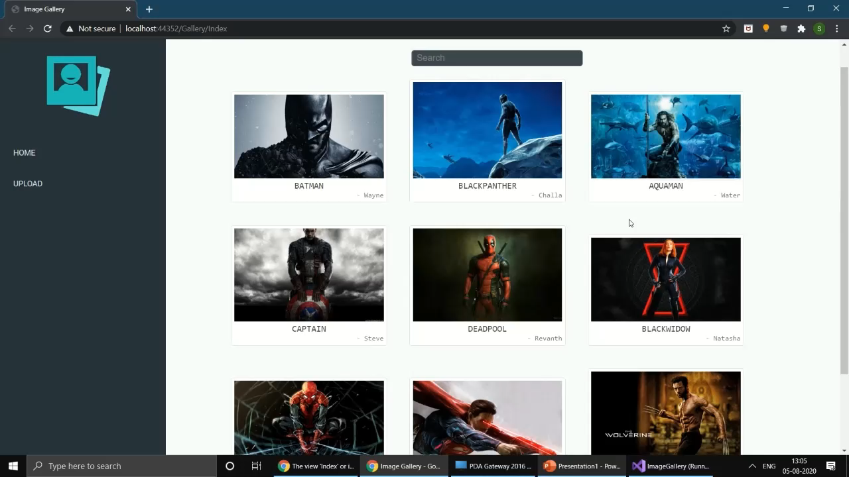
EXERCISE 3 - Web application walkthrough video

Slide 10
SESSION 5 – iHCM ARCHITECTURE
by Saravana Kumar
The products provided by ADP were briefed to us
There was a practical demo of creating a web page with the admin console

Slide 11
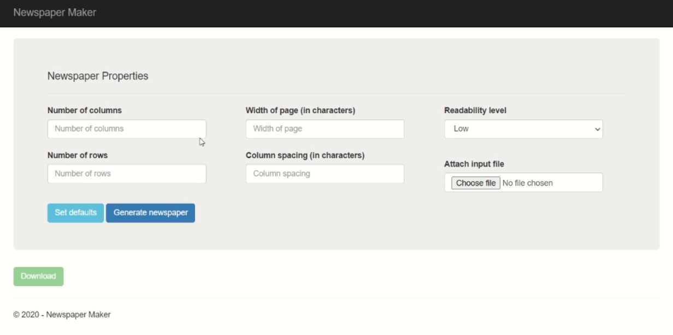
EXERCISE 4
To make a .NET Core Web API that will generate the model objects for a Newspaper and pass the objects to another API which prints the Newspaper to a text file
Along with the two APIs a web interface is also made to consume them
.NET core Web API ‘s inbuilt dependency injection techniques are explored
github.com/revanth6999/Newspaper

Slide 12
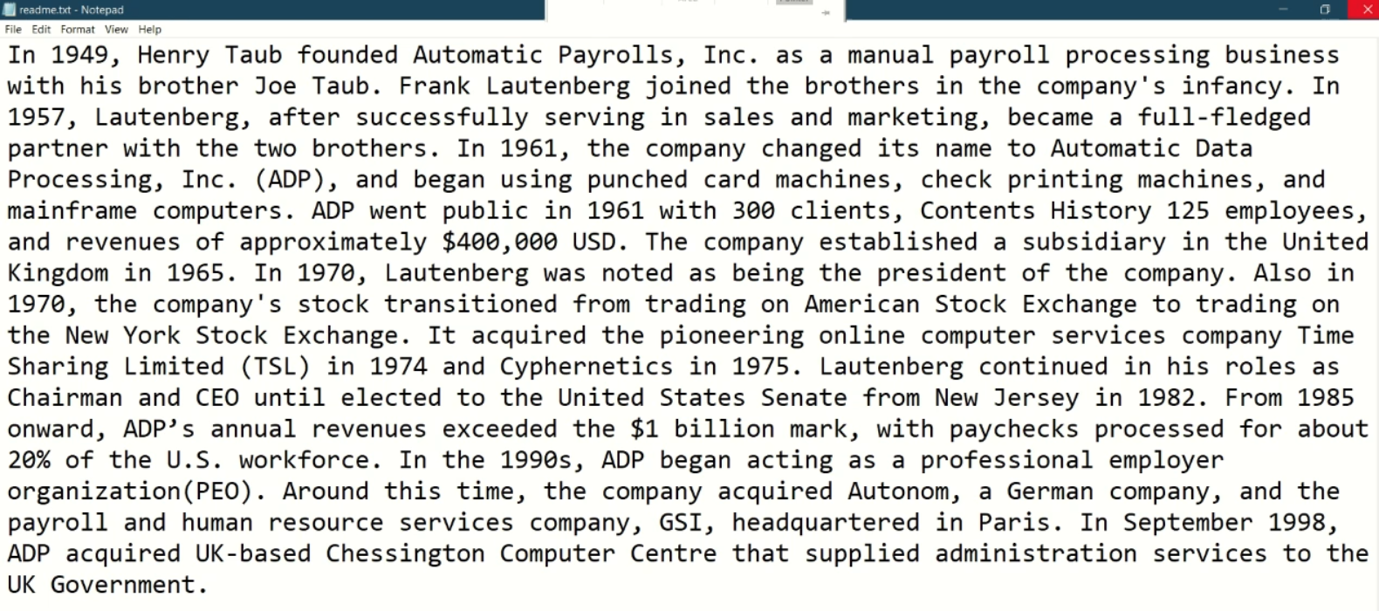
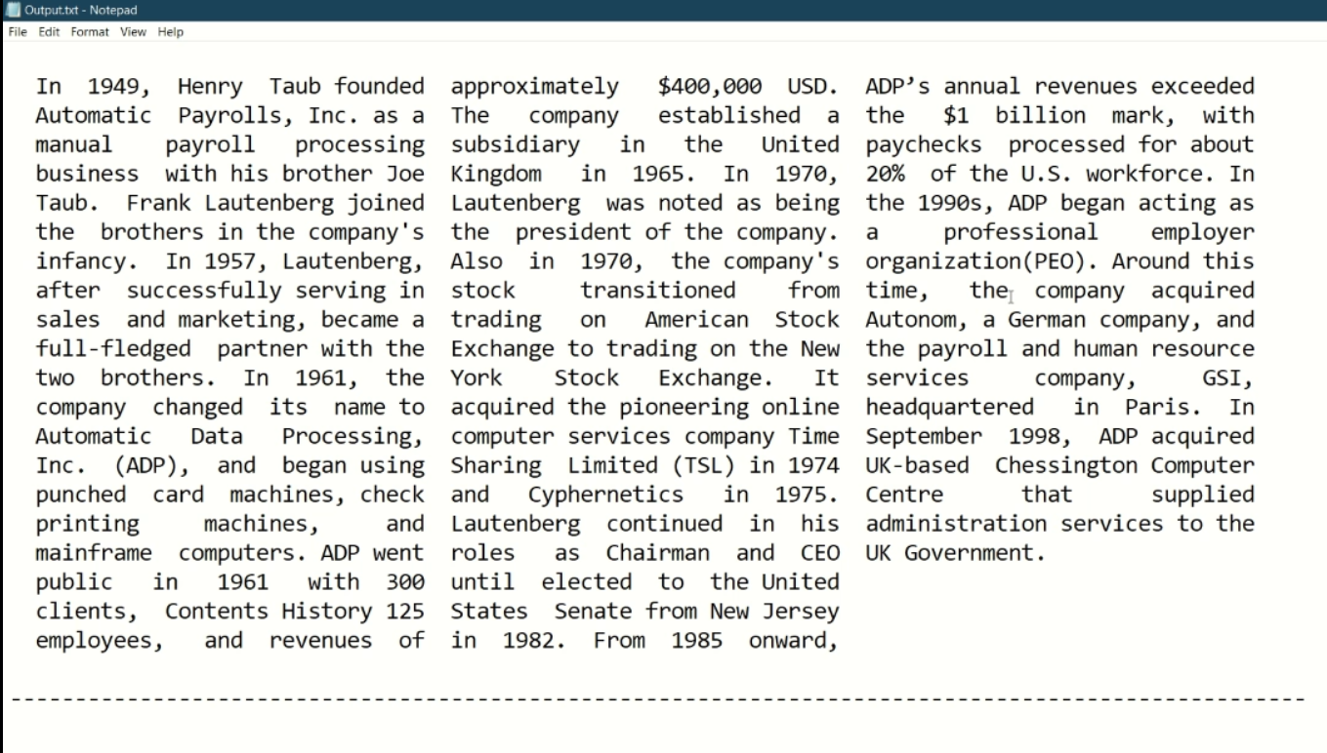
EXERCISE 4 – Sample Output

Slide 13
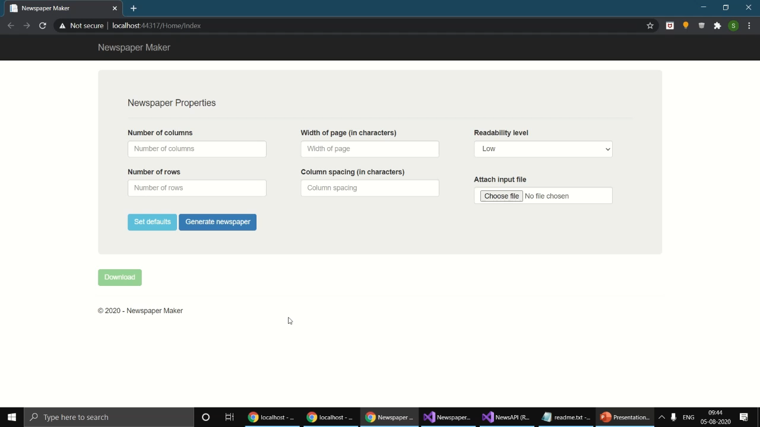
EXERCISE 4 - Web application walkthrough video

Slide 14
THANK YOU

